Slide 1


Leveraging the power of Kotlin for building Android apps
Monika Kumar Jethani
Android Engineer, Kotlin GDE
India

Slide 2
Agenda
Kotlin basics
Basics of Activities
Basics of Layouts
Basics of Fragments
Jetpack Navigation Component

Slide 3
Kotlin basics - val vs var
For immutable values use val
val name: String = “Monika”
name = “MJ” //compiler error
For mutable values use var
var name: String = “Monika”
name = “MJ” //works fine

Slide 4
Kotlin basics - Nullability
For nullable values use ?
val name: String = “Monika”
var middleName : String? = “Kumar”
middleName = null
For non-null values, no need for ?
var name: String = “Monika”
name = null //error

Slide 5
Kotlin basics - Operations on nullable types
val name: String? = “Monika”
val len : Int? = name?.length //6
val name: String? = null
val len : Int? = name?.length //null
//if len is non-null, then val len : Int = name?.length ?: 0 //0

Slide 6
Constants in Kotlin
Declared using const keyword
Value is immutable
Outside classes, inside Objects & Companion Objects
const val EVENT = “DevFest2021”

Slide 7
Const vs Val
Both are for immutable types.
Val can be inside a class whereas const cannot be inside a class(unless inside companion object)
Const is evaluated at compile time whereas val may be evaluated at run time
val result = checkIsPrimeNumber() //val is evaluated at run time

Slide 8
Functions in Kotlin
Declared using fun keyword
fun functionName(parameter1: DataType) : ReturnType {
//function body
}

Slide 9
Lateinit in Kotlin
For late initialization
Declared using lateinit keyword
lateinit var number: Int
number = 6

Slide 10
Lazy in Kotlin
For lazy initialization
Declared using lazy keyword
val nameTextView: TextView by lazy {
findViewById(R.id.nameTv)
}
nameTextView.text = “Monika”

Slide 11
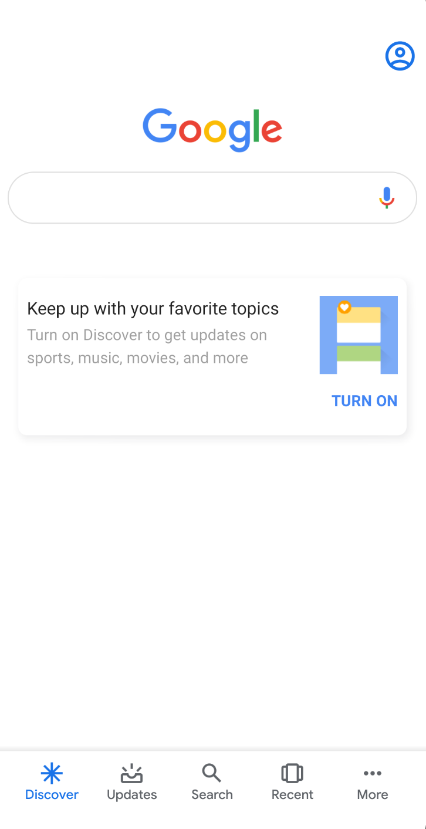
Activities
Single screen for user interaction

Slide 12
Let’s learn how to build activities & navigate between them

Slide 13
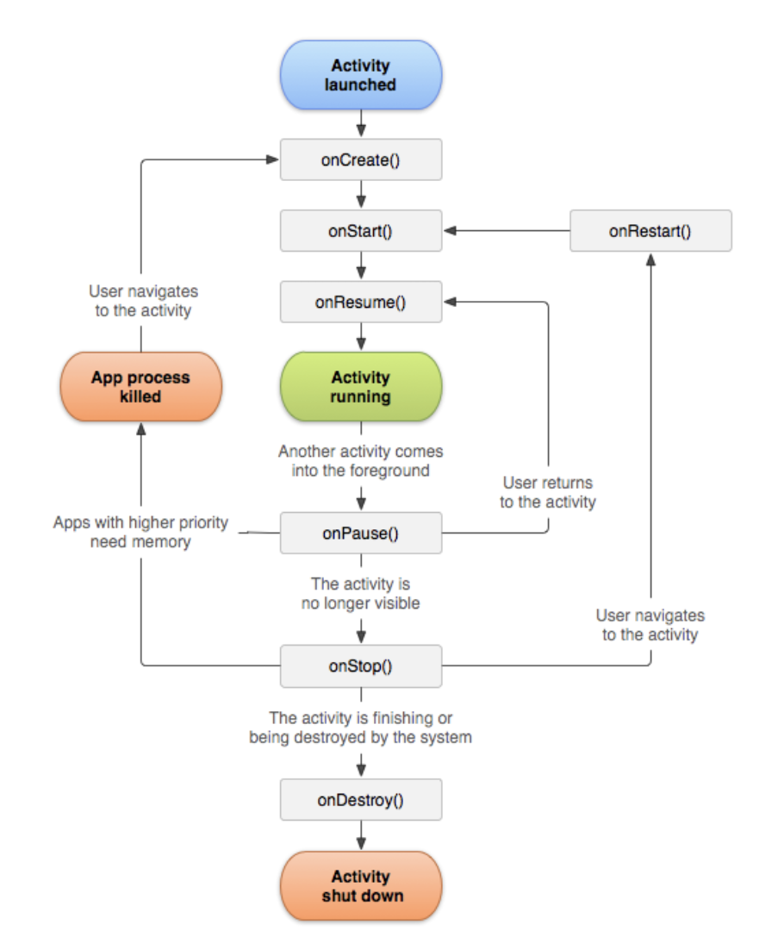
Activity Lifecycle
Source: developer.android.com

Slide 14
Is there a scenario when onDestroy() gets called without onPause() and onStop()?
Yes, when the activity calls finish()

Slide 15
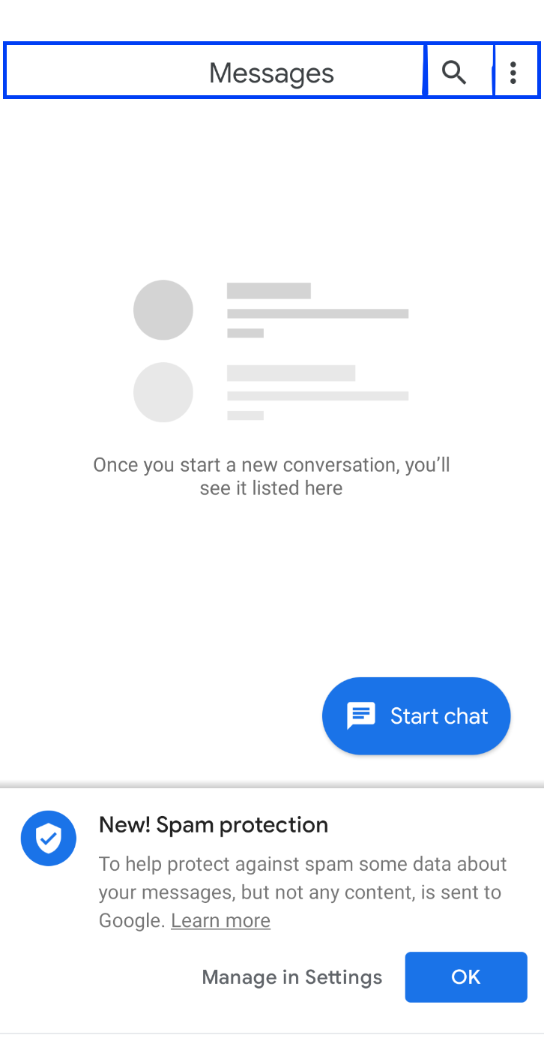
Views and ViewGroups
Views are UI Widgets like buttons, images, textviews
ViewGroups hold views & view groups & position them
Views

Slide 16
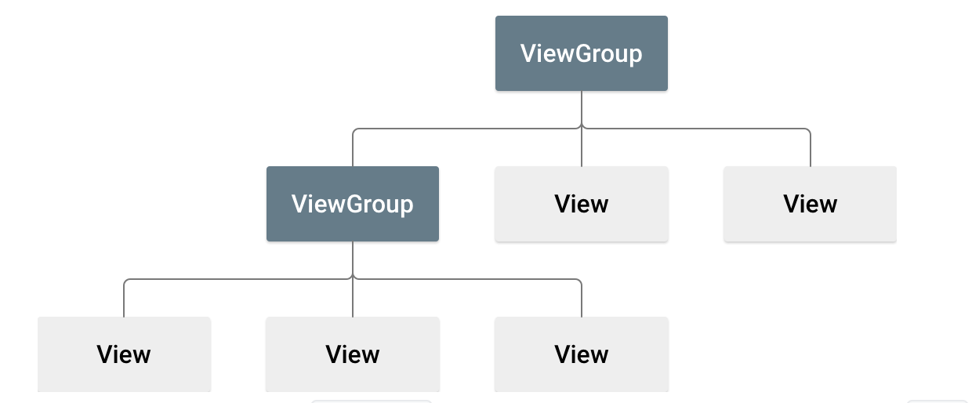
Source: developer.android.com

Slide 17
Commonly used layout - Constraint Layout
Each view should have atleast one horizontal and vertical constraint
Used to achieve flat layout hierarchy

Slide 18
Launch Modes
Standard
singleTop
singleTask
singleInstance

Slide 19
Standard Launch Mode
A -> B -> C -> D
Launch C
A -> B -> C -> D -> C

Slide 20
Single Top Launch Mode
A -> B -> C -> D
Launch C
If an instance of activity already exists at the top of the current task, a new instance will not be created and the Android system will route the intent information through onNewIntent().
Else, a new instance is created
A -> B -> C-> D -> C

Slide 21
Single Task Launch Mode
A -> B -> C -> D
Launch E
If activity instance is not present then the new instance will be created and if the instance is already present in the system then the onNewIntent() method will receive the callback.
A -> B -> C-> D -> E
Launch B
A -> B

Slide 22
Single Instance Launch Mode
A -> B -> C
Launch D
Task1: A -> B -> C
Task2 : D (here D will be in the different task)

Slide 23
Single Instance Launch Mode
Launch D
Task1: A -> B -> C
Task2 : D (Here old instance gets called and intent data route through onNewIntent() callback)

Slide 24
Fragments
Fragment represents a reusable portion of the app’s user interface.
Each has its own layout & lifecycle.
Cannot live on their own and must be hosted in another activity or fragment.

Slide 25
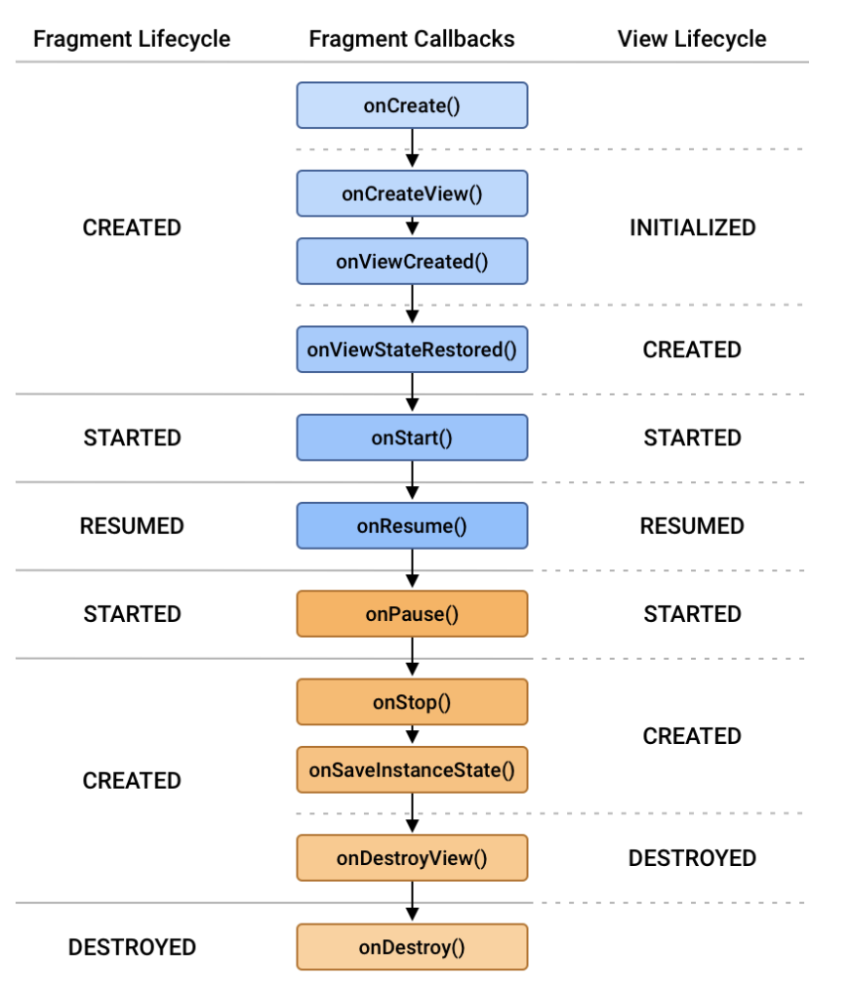
Fragment lifecycle
Source: developer.android.com

Slide 26
Let’s learn how to build fragments & navigate between them

Slide 27
How can fragments communicate with each other ?
Through View Model

Slide 28
Thank you

